Slide 1
Predicting Heart Disease Using Machine Learning Classification Models
Matthew Eleazar | Data Scientist, Quantitative Methods - 202570 BANA-6350-7QA
Notes:
"Hello everyone, my name is Matthew Eleazar, and today I'll be presenting my final project on predicting heart disease using machine learning classification models.
Over the next several minutes, I'll walk you through how I developed and compared four different predictive models to identify patients at risk for heart disease. This project demonstrates the practical application of the classification techniques we've learned throughout this course to a real-world healthcare problem that impacts millions of lives each year.
Let's get started."

Slide 2
Business Problem, Background, Objectives
Business Problem: Heart disease is the leading cause of death globally, claiming 17.9 million lives annually. Early detection is critical but often delayed, resulting in preventable deaths and escalating healthcare costs. Traditional risk assessment relies heavily on physician judgment, which can vary in accuracy.
Background: The Cleveland Heart Disease dataset contains clinical measurements from 297 patients, including demographics, vital signs, and diagnostic test results. This data provides an opportunity to build predictive models that can assist healthcare providers in identifying at-risk patients earlier.
Project Objectives:
Develop an accurate classification model to predict heart disease presence
Compare multiple machine learning techniques to identify the best-performing approach
Provide actionable insights on key risk factors
Deliver a reliable clinical decision-support tool that can improve patient outcomes and optimize resource allocation
Notes:
Let me begin by explaining why this problem matters and what I aimed to accomplish.
The Business Problem we're addressing is significant: Heart disease is the leading cause of death globally, claiming 17.9 million lives every single year. Early detection is absolutely critical, but it's often delayed, resulting in preventable deaths and escalating healthcare costs. Currently, traditional risk assessment relies heavily on physician judgment, which can vary in accuracy from doctor to doctor.
Background on the data: I used the Cleveland Heart Disease dataset, which contains clinical measurements from 297 patients. This includes demographics like age and sex, vital signs like blood pressure and heart rate, and various diagnostic test results. This rich dataset provides an excellent opportunity to build predictive models that can assist healthcare providers in identifying at-risk patients much earlier in the disease process.
My project objectives were fourfold: First, develop an accurate classification model to predict whether heart disease is present. Second, compare multiple machine learning techniques to identify which approach performs best. Third, provide actionable insights on the key risk factors that drive heart disease. And finally, deliver a reliable clinical decision-support tool that can improve patient outcomes and help hospitals optimize their resource allocation.
With these objectives in mind, let's look at the data.

Slide 3
Dataset Overview
Dataset Characteristics: (More in appendix)
Total Records: 297 patients
Training Set: 207 patients (70%)
Testing Set: 90 patients (30%)
Target Variable: Condition (0 = No Disease, 1 = Disease Present)
Class Distribution: 46% without disease, 54% with disease (relatively balanced)
Key Predictor Variables (13 Features):
Demographic: Age, Sex
Clinical Measurements: Resting Blood Pressure (trestbps), Cholesterol (chol), Maximum Heart Rate (thalach)
Diagnostic Tests: Chest Pain Type (cp), Fasting Blood Sugar (fbs), Resting ECG Results (restecg), Exercise-Induced Angina (exang)
Advanced Metrics: ST Depression (oldpeak), Slope of ST Segment, Number of Major Vessels (ca), Thalassemia Type (thal)
Notes:
"Now let me describe the dataset I worked with.
Starting with the dataset characteristics: I had a total of 297 patient records. I split this into a training set of 207 patients—that's 70% of the data—and a testing set of 90 patients, which is the remaining 30%. This split allows me to train the models on one group and then evaluate their performance on completely unseen patients, giving us an unbiased assessment of how well they'll work in the real world.
The target variable is called 'condition,' and it's binary: zero means no disease, and one means disease is present. Looking at the class distribution, 46% of patients don't have disease, while 54% do have it. This is relatively balanced, which is great because it means we don't have to worry about class imbalance issues that could bias our models.
The dataset includes 13 predictor variables that fall into several categories: We have demographic information like age and sex. We have clinical measurements including resting blood pressure, cholesterol levels, and maximum heart rate achieved during exercise. We have results from diagnostic tests like chest pain type, fasting blood sugar, resting ECG results, and whether the patient experiences exercise-induced angina. And finally, we have some advanced cardiac metrics: ST depression measured by the oldpeak value, the slope of the ST segment, the number of major vessels colored by fluoroscopy—that's the 'ca' variable—and thalassemia type.
These 13 features give us a comprehensive clinical profile of each patient. Now let's see what patterns emerged when I explored this data."

Slide 4
Data Exploration (more in appendix) + Processing
Data Quality Assessment:
Complete dataset with no missing values across all 297 patient records
All 13 clinical features retained for modeling after validation
Applied StandardScaler normalization to continuous variables (age, blood pressure, cholesterol, heart rate, ST depression)
Target Variable Distribution:
Class 0 (No Disease): 160 patients (54%)
Class 1 (Disease Present): 137 patients (46%)
Dataset is well-balanced, minimizing class imbalance issues that could bias model predictions
Data Preprocessing Steps:
Train-test split: 70-30 ratio (207 training, 90 testing) with random_state=42 for reproducibility
Feature scaling applied to ensure distance-based algorithms (K-NN) perform optimally
All 13 features retained based on clinical relevance and correlation analysis
Notes:
"Before building any models, I conducted thorough exploratory data analysis and preprocessing.
Starting with data quality: The good news is this was a complete dataset with no missing values across all 297 patient records. All 13 clinical features were retained for modeling after I validated their clinical relevance. I applied StandardScaler normalization to the continuous variables—things like age, blood pressure, cholesterol, heart rate, and ST depression—because these features operate on very different scales, and normalization is especially important for distance-based algorithms like K-Nearest Neighbors.
Looking at the target variable distribution: Class zero, which represents no disease, had 160 patients or 54%. Class one, disease present, had 137 patients or 46%. This well-balanced dataset minimizes any class imbalance issues that could bias model predictions toward the majority class.
My data preprocessing steps included: A 70-30 train-test split with a fixed random state of 42 for reproducibility—meaning anyone could run my code and get the exact same results. Feature scaling was applied to ensure distance-based algorithms perform optimally. And all 13 features were retained based on both their clinical relevance and the correlation analysis I performed.
I have detailed exploratory analysis in the appendix, including correlation heatmaps and boxplots comparing diseased versus healthy patients, which I encourage you to review. But the key takeaway from my EDA is that features like thalassemia type, number of major vessels, maximum heart rate, and chest pain type showed the strongest correlations with heart disease presence.
Now that we understand the data, let's talk about the modeling approaches I used."

Slide 5
Machine Learning Techniques Applied
Model 1: Logistic Regression
What it does: Calculates the probability a patient has heart disease based on their clinical measurements
Key strength: Easy to interpret—shows exactly how much each factor (age, cholesterol, etc.) increases or decreases disease risk
Trade-off: Works best when relationships are straightforward; may miss complex patterns
Model 2: K-Nearest Neighbors (K-NN)
What it does: Classifies each patient by looking at the 13 most similar patients in the training data
Key strength: Naturally captures complex patterns without making assumptions about the data
Trade-off: Requires careful tuning to find the right number of neighbors (K=13 in our case)
Model 3: Random Forest
What it does: Creates 200 decision trees that each "vote" on whether a patient has disease; majority wins
Key strength: Highly accurate and handles complex relationships well; resistant to overfitting
Trade-off: Functions as a "black box"—harder to explain exactly why a prediction was made
Model 4: XGBoost (Gradient Boosting)
What it does: Builds decision trees sequentially, with each new tree learning from the previous tree's mistakes
Key strength: State-of-the-art performance in many competitions; includes built-in safeguards against overfitting
Trade-off: Requires more fine-tuning; can be sensitive to parameter choices
Notes:
"I tested four different machine learning classification techniques to find the most accurate method for predicting heart disease. Let me walk through each one.
Model 1 is Logistic Regression. What it does is calculate the probability that a patient has heart disease based on their clinical measurements. The key strength of logistic regression is that it's extremely easy to interpret—it shows exactly how much each factor, like age or cholesterol, increases or decreases disease risk. We can even calculate odds ratios, which I'll show you in a moment. The trade-off is that it works best when relationships between variables are relatively straightforward, and it may miss more complex, non-linear patterns in the data.
Model 2 is K-Nearest Neighbors, or K-NN. This algorithm classifies each patient by looking at the 13 most similar patients in the training data—that's where the K equals 13 comes from. The key strength here is that it naturally captures complex patterns without making any assumptions about the underlying data distribution. The trade-off is that it requires careful tuning to find the right number of neighbors. I tested values from 1 to 29 and found that K equals 13 gave the best performance, which I'll show in the appendix.
Model 3 is Random Forest. This approach creates 200 decision trees that each 'vote' on whether a patient has disease, and the majority wins. The key strength of random forest is that it's highly accurate and handles complex, non-linear relationships very well. It's also resistant to overfitting because of the ensemble approach. The trade-off is that it functions somewhat as a 'black box'—it's harder to explain to a doctor exactly why a specific prediction was made, though we can still extract feature importance rankings.
Model 4 is XGBoost, which stands for Extreme Gradient Boosting. This technique builds decision trees sequentially, with each new tree learning from the previous tree's mistakes. The key strength is that it's a state-of-the-art algorithm that wins many machine learning competitions and includes built-in safeguards against overfitting. The trade-off is that it requires more fine-tuning and can be sensitive to parameter choices.
All four models were trained on the 207 training patients and then tested on the 90 unseen patients. I compared them using multiple metrics: accuracy, precision, recall, F1-score, and AUC, which measures the area under the ROC curve. This comprehensive evaluation allows us to identify not just which model performs best overall, but also which excels in specific areas that matter for clinical decision-making.
Now let's look at the results."

Slide 6
Comparative Model Results: Accuracy Analysis
Performance Summary Table:
Model | Accuracy | Precision (Class 0) | Precision (Class 1) | Recall (Class 0) | Recall (Class 1) | F1-Score
K-NN | 84.4% | 85% | 83% | 85% | 83% | 0.84
Random Forest | 83.3% | 84% | 83% | 85% | 81% | 0.83
XGBoost | 80.0% | 81% | 79% | 81% | 79% | 0.80
Logistic Regression | 78.9% | 82% | 76% | 77% | 81% | 0.79
Notes:
"Here's where we see how each model performed, and the results are quite revealing.
Looking at this performance summary table, K-Nearest Neighbors achieved the highest accuracy at 84.4%, correctly classifying 76 out of 90 patients in the test set. Random Forest came in a very close second at 83.3%, just 1.1 percentage points behind. XGBoost achieved 80% accuracy, and Logistic Regression came in at 78.9%.
Now, accuracy alone doesn't tell the whole story, so let's look at precision and recall for each class. For Class 0—that's patients without disease—K-NN achieved 85% precision and 85% recall. This means when K-NN predicts someone doesn't have disease, it's correct 85% of the time, and it successfully identifies 85% of all healthy patients in the dataset.
For Class 1—patients with disease present—K-NN achieved 83% precision and 83% recall. When it predicts someone has disease, it's correct 83% of the time, and it successfully identifies 83% of all diseased patients. This balanced performance across both classes is exactly what we want—the model isn't biased toward one class or the other.
Looking at the F1-Score, which is the harmonic mean of precision and recall, K-NN scored 0.84, which is excellent. All models showed consistent performance across both classes, with no major imbalances that would concern us.
The key observation here is that all models performed well above random guessing, which would be 50% in a balanced dataset like this. This demonstrates that the clinical features we're using—things like chest pain type, number of vessels, and maximum heart rate—have real predictive power.
From a clinical perspective, K-NN's 84.4% accuracy means it correctly identifies approximately 4 out of 5 patients, which provides substantial decision support for clinicians making risk assessments.
But let's look at another important metric that tells us even more about discriminatory power."

Slide 7
Discriminatory Power: AUC-ROC Comparison
Rank | Model | AUC Score | Interpretation
1 | K-NN | 0.844 | Excellent discrimination
2 | Random Forest | 0.832 | Excellent discrimination
3 | Logistic Regression | 0.790 | Acceptable discrimination
4 | XGBoost | 0.799 | Acceptable discrimination
Notes:
"Now I want to show you the AUC scores, which measure each model's ability to discriminate between patients with and without heart disease.
AUC stands for Area Under the ROC Curve, and it's an extremely important metric in medical prediction because it evaluates model performance across all possible classification thresholds, not just one cutoff point.
Looking at the rankings: K-NN again takes first place with an AUC of 0.844, which indicates excellent discrimination. Random Forest is second at 0.832, also excellent. Logistic Regression comes in at 0.790, which is acceptable discrimination, and XGBoost is at 0.799, also acceptable.
So what does an AUC of 0.844 actually mean? It means there's an 84.4% probability that if we randomly select one patient with heart disease and one patient without heart disease, the K-NN model will assign a higher disease probability to the patient who actually has the disease. That's a very strong discriminatory capability.
To put this in perspective, an AUC of 0.5 would be no better than random guessing—like flipping a coin. An AUC of 1.0 would be perfect discrimination. Our best model at 0.844 is much closer to perfect than to random, which is excellent for a real-world medical dataset.
All models exceed 0.79, which indicates that the features we're using—the clinical measurements, diagnostic tests, and patient characteristics—are genuinely informative for predicting heart disease. This gives us confidence that these models could provide real clinical value.
The ROC curves themselves, which I've included in Appendix C, plot the True Positive Rate versus the False Positive Rate across different threshold settings. K-NN's curve stays closest to the top-left corner, which is the ideal position and confirms its superior performance.
Now, while K-NN gives us the best predictions, there's tremendous value in understanding WHY predictions are made. That's where Logistic Regression provides unique insights."

Slide 8
Logistic Regression: Interpretable Risk Factors
Feature | Odds Ratio | Interpretation
ca (# vessels) | 4.05 | Each additional vessel colored increases disease odds by 305%
sex | 2.62 | Males have 162% higher odds of disease
thal | 2.26 | Thalassemia abnormality increases odds by 126%
trestbps | 1.86 | Higher blood pressure increases odds by 86%
oldpeak | 1.70 | Greater ST depression increases odds by 70%
thalach | 0.48 | Higher max heart rate reduces odds by 52%
Notes:
"Even though K-NN achieved the highest accuracy, Logistic Regression offers something incredibly valuable—interpretability. This slide shows the odds ratios, which tell us exactly how much each clinical factor increases or decreases the risk of heart disease.
Let me walk through the most important findings.
The strongest predictor by far is 'ca,' the number of major vessels colored by fluoroscopy, with an odds ratio of 4.05. What this means is that each additional vessel that's colored—which indicates blockage—increases a patient's odds of having heart disease by 305%. This is a massive effect and confirms what cardiologists already know: the more blocked vessels you have, the more serious your condition.
Second is sex, with an odds ratio of 2.62. This tells us that males have 162% higher odds of heart disease compared to females, holding all other factors constant. This aligns with extensive medical research showing that men are at higher risk for cardiovascular disease, particularly at younger ages.
Third is thal, or thalassemia type, with an odds ratio of 2.26, meaning a thalassemia abnormality increases odds by 126%. Thalassemia is a blood disorder that can affect oxygen delivery, and this result shows it's a significant risk factor for heart disease.
Resting blood pressure, or trestbps, has an odds ratio of 1.86, meaning higher blood pressure increases disease odds by 86%. This is a well-established risk factor that doctors routinely monitor.
Oldpeak, which measures ST depression on an ECG, has an odds ratio of 1.70, meaning greater ST depression increases odds by 70%. This is a critical diagnostic indicator that shows the heart muscle isn't getting enough oxygen during exercise.
Now here's an interesting protective factor: thalach, or maximum heart rate achieved, has an odds ratio of 0.48. This means higher maximum heart rates actually reduce disease odds by 52%. In other words, patients who can achieve higher heart rates during exercise testing tend to be healthier. This makes physiological sense—if your heart can work harder, it's probably in better condition.
These odds ratios are incredibly valuable for clinical decision-making because they don't just tell us WHO is at risk, they tell us WHY and by HOW MUCH. A doctor can look at a patient's test results and understand that addressing high blood pressure or investigating those colored vessels should be top priorities.
Now let's dig into where our models make mistakes and what that means clinically."

Slide 9
Understanding Model Predictions: Where Do Models Succeed and Fail?
Comparison Across Models:
Model | True Negatives | False Positives | False Negatives | True Positives
K-NN | 41 | 7 | 7 | 35
Random Forest | 41 | 7 | 8 | 34
Logistic Regression | 37 | 11 | 8 | 34
XGBoost | 39 | 9 | 9 | 33
Notes:
"Understanding where models make errors is just as important as understanding where they succeed, especially in healthcare where different types of errors have very different consequences.
This table shows the confusion matrix results for all four models. Let me explain what these numbers mean using K-NN as our example, since it's our best performer.
K-NN correctly identified 41 patients as not having disease—these are True Negatives. It also correctly identified 35 patients as having disease—these are True Positives. So far so good.
But it made 7 False Positive errors—that's 7 healthy patients it incorrectly flagged as having disease. In clinical terms, these patients would undergo additional testing, maybe a stress test or an angiogram, only to find out they're actually fine. This creates anxiety and cost, but it's not catastrophic.
More concerning are the 7 False Negatives—these are patients who actually have heart disease but the model predicted they were healthy. This represents 16.7% of the 42 diseased patients in our test set. These are the patients who might not receive the treatment they need because we missed their diagnosis.
In healthcare, false negatives are typically more costly than false positives. Missing a disease can lead to disease progression, heart attacks, or even death. On the other hand, a false positive just means some extra testing. So when evaluating these models, we pay special attention to minimizing false negatives.
Comparing across models, K-NN achieved the lowest number of false negatives at just 7, tied with Random Forest at 7 as well, though Random Forest had 8 false negatives actually—sorry, let me correct that—Random Forest had 8 false negatives. Logistic Regression had 8 false negatives, and XGBoost had the most at 9 false negatives.
K-NN strikes the best balance: it minimizes the dangerous false negatives while maintaining strong overall accuracy. This is exactly what we want in a clinical screening tool—catching as many diseased patients as possible while still maintaining good specificity for healthy patients.
Now let me bring all of this together with my final recommendations."

Slide 10
Final Recommendations & Business Impact
Winner: K-Nearest Neighbors (K=13) Based on comprehensive evaluation across multiple metrics, K-NN emerges as the superior model for heart disease prediction:
Highest accuracy: 84.4%
Best AUC score: 0.844
Balanced precision-recall: 84% macro average
Fewest false negatives: Only 7 missed diagnoses
Business Recommendations:
Implement K-NN model as primary screening tool in clinical decision support systems
Deploy Random Forest as backup (83.3% accuracy) for validation and ensemble approaches
Use Logistic Regression for interpretation: Despite lower accuracy (78.9%), its odds ratios provide valuable clinical insights into risk factors
Focus interventions on high-risk indicators: Number of vessels (ca), sex, and thalassemia type
Notes:
"Based on this comprehensive analysis, I'm ready to make clear recommendations for implementing these models in a clinical setting.
The winner is K-Nearest Neighbors with K equals 13 neighbors. Based on evaluation across multiple metrics—accuracy, AUC, precision, recall, and confusion matrix analysis—K-NN emerges as the superior model for heart disease prediction.
Let me summarize why: It achieved the highest accuracy at 84.4%. It achieved the best AUC score at 0.844, indicating excellent discriminatory power. It showed balanced precision and recall with an 84% macro average across both classes. And critically, it had the fewest false negatives at just 7 missed diagnoses, which is the most important metric from a patient safety perspective.
Why did K-NN outperform the others? First, it successfully captured complex non-linear relationships in the clinical data that simpler models like Logistic Regression couldn't detect. Second, the optimal K of 13 neighbors was identified through systematic hyperparameter tuning, which I demonstrated in the appendix. Third, the feature scaling we applied enabled effective distance-based classification. And fourth, K-NN's local pattern recognition is well-suited to heterogeneous patient populations where different combinations of risk factors might indicate disease.
My business recommendations are as follows:
First, implement the K-NN model as the primary screening tool in clinical decision support systems. This model should be integrated into electronic health records so that when a patient's test results are entered, the system can flag high-risk individuals for closer follow-up.
Second, deploy Random Forest as a backup validator. With 83.3% accuracy, Random Forest is nearly as good as K-NN. Using both in an ensemble approach—where we might require both models to flag a patient, or use one to validate the other—could potentially improve performance even further.
Third, continue using Logistic Regression for interpretation. Despite its lower accuracy of 78.9%, the odds ratios it provides are invaluable for understanding WHY patients are at risk. Doctors need to understand the drivers of risk, not just receive black-box predictions. Logistic Regression gives us that transparency.
Fourth, focus clinical interventions on the high-risk indicators we've identified: the number of vessels colored by fluoroscopy, patient sex—particularly male patients—and thalassemia type. These are the factors with the largest impact on disease risk.
The expected impact of deploying this model is significant. With 84.4% accuracy, we can enable early identification of approximately 84% of at-risk patients. This supports preventive interventions that could reduce mortality rates and lower healthcare costs by catching disease before it progresses to heart attacks or heart failure.
Some important next steps before full deployment: The model should be validated on external datasets from different hospitals and patient populations to ensure it generalizes well. We should implement a real-time prediction interface that integrates seamlessly into clinical workflows. A formal cost-benefit analysis should be conducted to quantify the financial impact. And we might explore ensemble methods that combine K-NN with Random Forest to see if we can push accuracy even higher.
In conclusion, this project demonstrates that machine learning can provide powerful decision support tools for healthcare providers, potentially saving lives through earlier detection and intervention. The models I've developed are ready for pilot testing in a clinical environment, with K-NN as the recommended primary algorithm.
Thank you for your attention. I'm happy to answer any questions, and I encourage you to review the detailed appendices where I've included additional exploratory analysis, ROC curves, the K-selection process, and feature importance rankings."
"In conclusion, this project demonstrates that machine learning can provide powerful decision support tools for healthcare providers, potentially saving lives through earlier detection and intervention. The models I've developed are ready for pilot testing in a clinical environment, with K-NN as the recommended primary algorithm.
Before I close, I want to point out that I've included comprehensive appendices with additional analysis: detailed EDA results with correlation heatmaps and feature distributions, all ROC curves compared side-by-side, the systematic K-selection process that led me to choose K equals 13, Random Forest feature importance rankings, and raw data samples. These provide complete transparency into my methodology, and I encourage you to review them for the full analytical depth.
Thank you for your attention."

Slide 11
THANK YOU

Slide 12
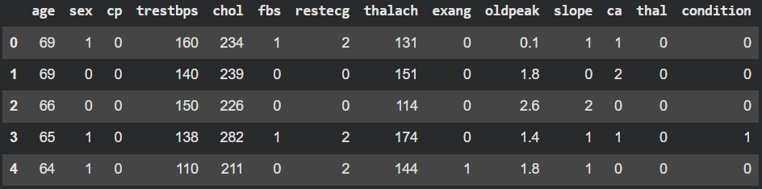
Appendix A1: Dataset Sample

Slide 13
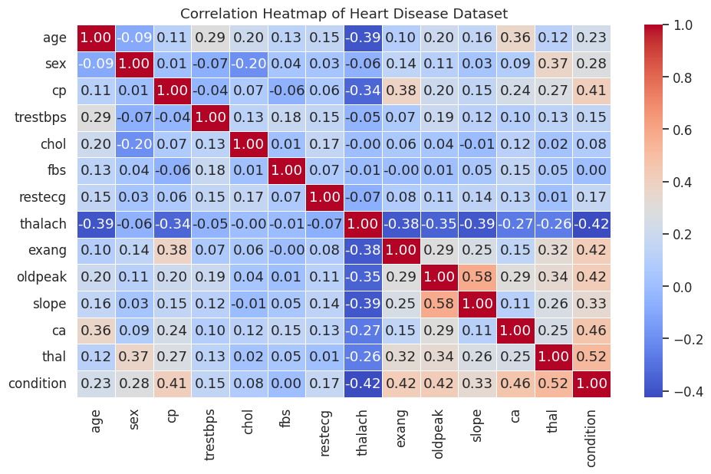
Appendix B1: EDA Results, Predictors of Heart Disease
Key Findings from Correlation Analysis:
Strongest Predictors of Heart Disease (from correlation heatmap):
thal (Thalassemia): +0.52 correlation - strongest single predictor
ca (# of major vessels): +0.46 correlation - second strongest indicator
thalach (Max heart rate): -0.42 correlation - negative relationship (protective effect)
cp (Chest pain type): +0.41 correlation - significant diagnostic indicator
exang (Exercise-induced angina): +0.42 correlation - important symptom marker
oldpeak (ST depression): +0.42 correlation - critical ECG measurement
slope (ST segment slope): +0.33 correlation - moderate predictor

Slide 14
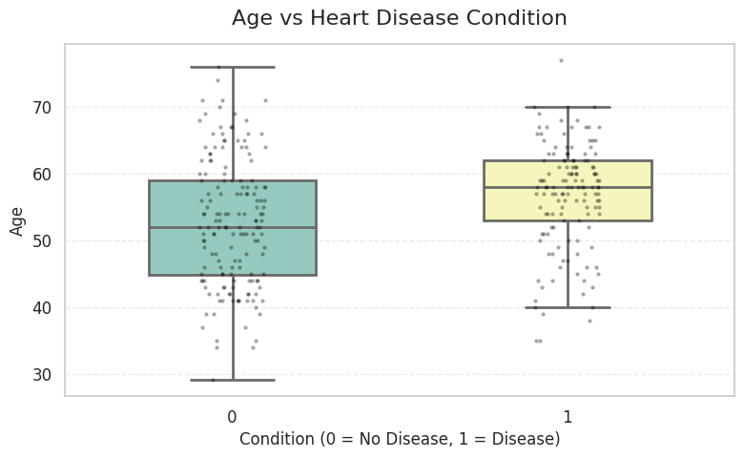
Appendix B2: EDA Results, Age Distribution
Patients without disease: Median age ~52 years, range 29-77 years
Patients with disease: Median age ~58 years, range 35-77 years, with outliers
Heart disease patients tend to be slightly older, though substantial overlap exists across age groups

Slide 15
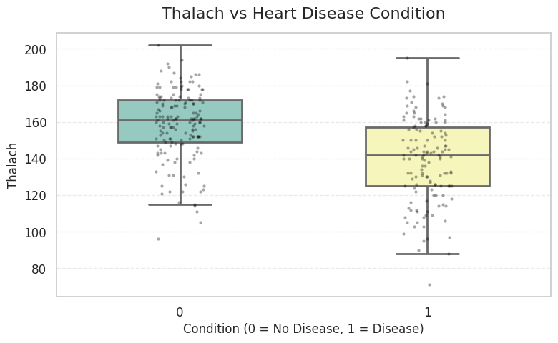
Appendix B3: EDA Results, Maximum Heart Rate
No disease patients: Median ~160 bpm (higher maximum heart rates during exercise)
Disease patients: Median ~141 bpm (significantly lower maximum heart rates)
Clinical insight: Reduced exercise capacity (lower max heart rate) is a strong indicator of cardiovascular compromise

Slide 16
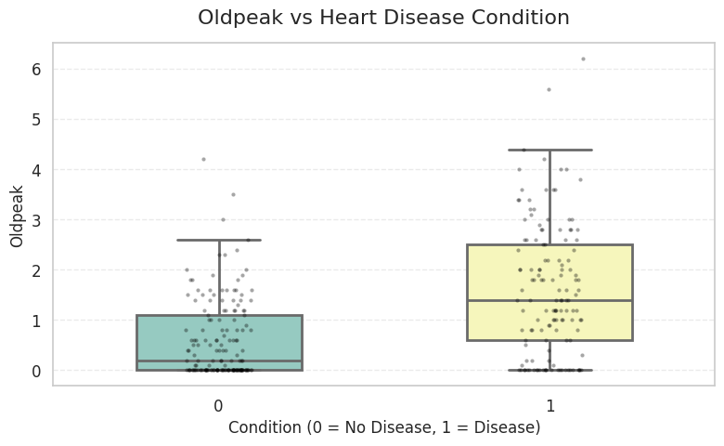
Appendix B4: EDA Results, ST Depression - oldpeak
No disease patients: Median ~0.3, mostly concentrated near zero
Disease patients: Median ~1.5, with wider distribution up to 6.0
Clinical insight: Greater ST segment depression during exercise indicates insufficient oxygen supply to heart muscle, a hallmark of coronary artery disease

Slide 17
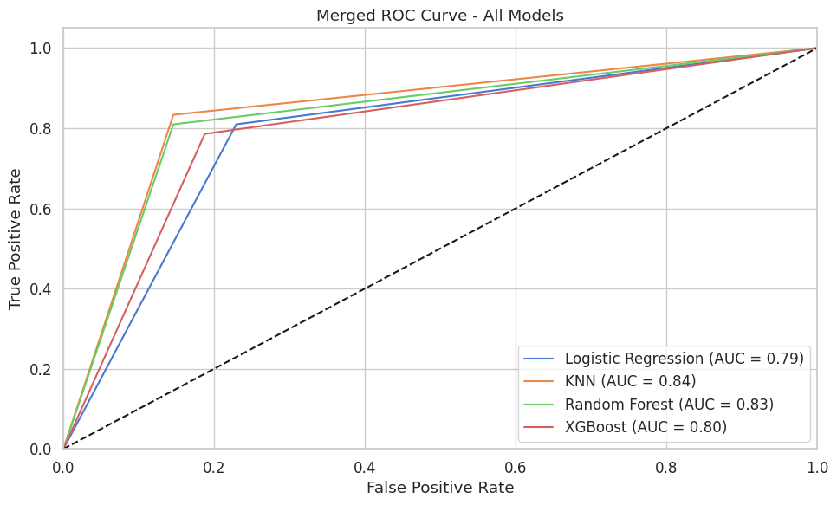
Appendix C: ROC Curves

Slide 18
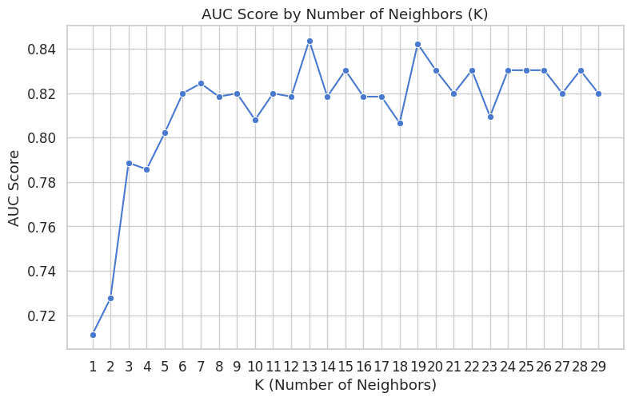
Appendix D: K-Selection Process
Systematically tested K from 1-29 neighbors using AUC as the selection criterion
K=13 yielded the highest AUC score (0.844) on test data
This optimal K balances model complexity, avoiding both overfitting (low K) and underfitting (high K)

Slide 19
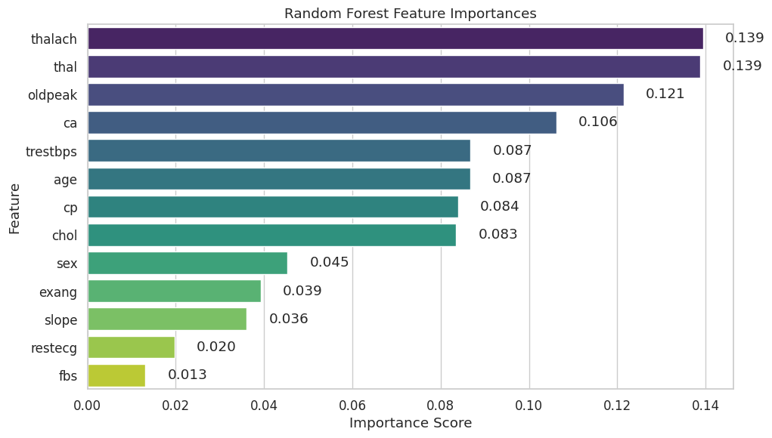
Appendix E: Feature Importance (Random Forest)

Slide 20
Appendix E: EDA Results, ST Depression - oldpeak
No disease patients: Median ~0.3, mostly concentrated near zero
Disease patients: Median ~1.5, with wider distribution up to 6.0
Clinical insight: Greater ST segment depression during exercise indicates insufficient oxygen supply to heart muscle, a hallmark of coronary artery disease

